Slide 1
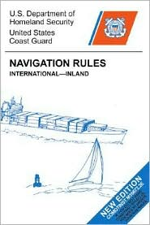
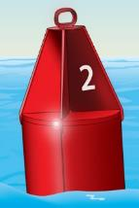
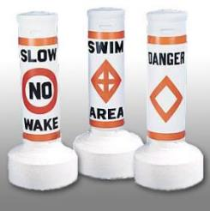
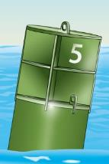
MOTORBOAT TRAINING, testing and licensing
Presenter:
Title: Rules of the Road &
Aids to Navigation (ATONS)
Manual – TAB 4
Date:

Slide 2
Navigation Rules
“The Rules of the Road”
Objectives:
Learn the purpose of “Rules”
Learn Navigational terms
Learn to interpret navigation lights
Learn the basic Inland Navigation Rules for crossing, meeting & overtaking situations.
Learn the “Pecking Order” for vessels

Slide 3
Who wrote the rules?
“Navigation Rules”
Are published by the U.S. Department of Homeland Security for the United States Coast Guard
Updated copies can be downloaded online at:
www.navcen.uscg.gov

Slide 4
What do the Rules do?
If followed, they protect against loss of life, injury, and property damage as a result of collision.
Prevent Accidents

Slide 5
Where do the Rules apply?
On US Inland or International Waters.
( Rule 1)

Slide 6
Most Collisions Could Be Avoided By…
Practicing the “Rules of the Road” – Rule 1
Use of a “proper lookout” – Rule 5
Maintaining safe speed – Rule 6
Displaying proper lights - Rule 20
Knowing the “Aids to Navigation”

Slide 7
Ground Rules for Navigation
Responsibility & Definitions

Slide 8
General Definitions
Underway - not at anchor or made fast to the shore or aground
Right-of-way – the right and duty to maintain course and speed
Stand-On Vessel – vessel that has the right of way
Give Way Vessel – must keep clear of the stand-on vessel
Short Blast - a blast of approximately 1 second
Prolonged Blast – a blast of 4 to 6 seconds

Slide 9
General Definitions cont’d
Safe Speed - Speed that allows proper and effective action to avoid collision based on the following factors.
Visibility
Traffic density and characteristics.
Maneuverability, draft.
Background clutter.
Weather, wind, current, navigational hazards

Slide 10
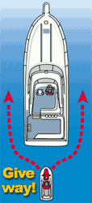
ENCOUNTERING OTHER VESSELS
RULE 13 OVERTAKING - Vessel that is passed by another from a position more than 22.5 degrees abaft of it’s beam is the stand-on vessel. The give-way vessel should not see the green or red navigation sidelights. If in doubt whether overtaking or crossing, always assume overtaking.
Give-way vessel will keep clear of stand-on vessel until finally well past and clear.
But be careful! White light only could also indicate a vessel sailing or a vessel at anchor or under oars.

Slide 11
RULE 14 HEAD ON - When two power-driven vessels are on reciprocal courses, vessels will steer to starboard so each shall pass port to port of each other. At night, vessels in a head-on situation should observe masthead light(s) in a line and one or both sidelights.

Slide 12
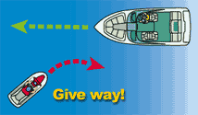
RULE 15 CROSSING - A vessel which has another vessel on her starboard side shall keep out of the way of the other and if necessary, avoid crossing ahead of the other vessel. On the Great Lakes and Western Rivers, a vessel crossing a river shall keep out of the way of an ascending or descending vessel.

Slide 13
Rule 18 Responsibilities Between Vessels (Inland)
R.O.W. Pecking Order
Privileged
Not under command (NUC)
Restricted in ability to maneuver (RAM) (dredging, mine sweeping)
Fishing/trawling (not trolling)
Sail or manually powered boat
Power-driven
Seaplane
Burdened

Slide 14
Navigation Lights and Shapes (Rules 20 - 31)
White 360 degree light required when anchored
Red and Green lights (112.5 degree arc) required when underway between sunset and sunrise or in restricted visibility

Slide 15
RULES 20 thru 31 LIGHTS AND SHAPES
Sidelight
Port
112.5
Sidelight
starboard
112.5
Masthead 225
22.5
22.5
Abaft of Beam
Abaft of Beam
Stern light
135
ARCS OF VISIBILITY

Slide 16
Navigation Lights
Navigation lights should be checked prior to departing the dock
Lights should be used between sunset and sunrise and during restricted visibility
Always carry spare bulbs

Slide 17
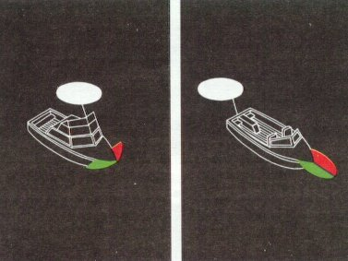
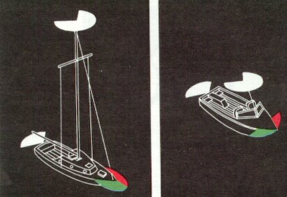
Configurations
Class A-I Under Power

Slide 18
What are we seeing from these four light configurations?

Slide 19
RULES 34 MANUEVERING AND WARNING
Inland
Signals of intent with appropriate reply required
One short - I intend to pass you on my port side
Two short - I intend to pass you on my starboard side
Three short - I am operating astern (reverse) propulsion
Five short – Danger, I do not understand, I disagree
Inland Rules require the other vessel to answer with the same signal if in agreement

Slide 20
Review
What is the purpose of the Navigation Rules?
What is the definition of “underway”?
What does one short blast indicate?
What does two short blasts indicate?
What does three short blasts indicate?
What does five short blasts indicate?
T or F? The overtaken vessel is the give-way vessel
What’s the arc of visibility for sidelights?
What’s the arc of visibility for a stern light?
What is the pecking order in the vessel “hierarchy”?

Slide 21
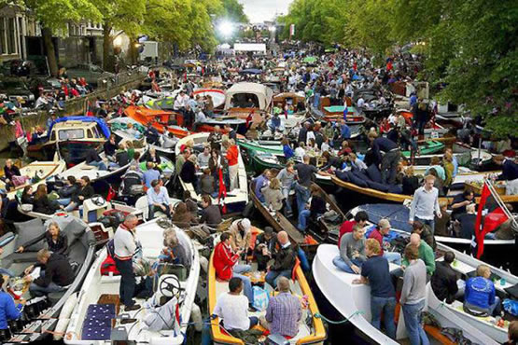
QUESTIONS?

Slide 22
AIDS TO NAVIGATION (ATON)
Objectives:
Identify the Navigation Systems
IALA (International Association of Lighthouse Authorities)
U.S. Aids to Navigation
Intracoastal Waterway
Western Rivers
Uniform State Waterway Marking System
Identify the Types of ATONs
Learn the application of Regulatory Buoys

Slide 23
To safely transit from one place to another
we use AIDS TO NAVIGATION (ATONS)…

Slide 24
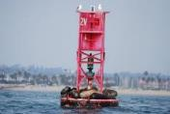
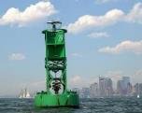
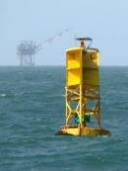
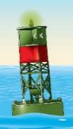
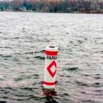
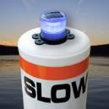
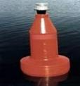
Two Types of Aids to Navigation:
Buoys and Beacons; Both have various shapes, sounds and light characteristics.
Buoys
Nun Can Bell Whistle Gong
Spar Lighted buoys

Slide 25
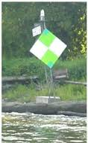
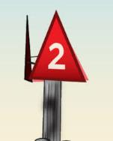
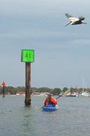
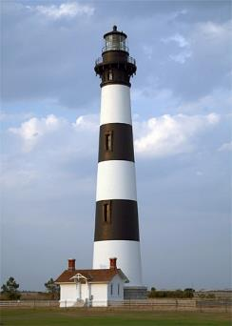
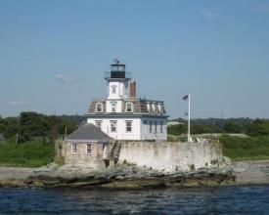
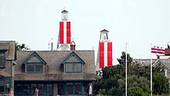
Beacons

Slide 26
Navigation Systems
International Association of Lighthouse Authorities (IALA)
The world is divided into Region A or B

Slide 27
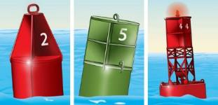
Green or red lateral aids show channel edges
IALA System A and IALA System B regulate navigational markings throughout most of the world.
System A is generally used in the Eastern Hemisphere
System B is generally used in the Western Hemisphere.
In Region A, green aids are on the right when returning from sea.
In Region B, red aids are on the right. RED-RIGHT-RETURNING

Slide 28
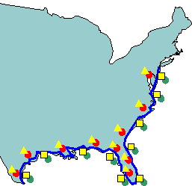
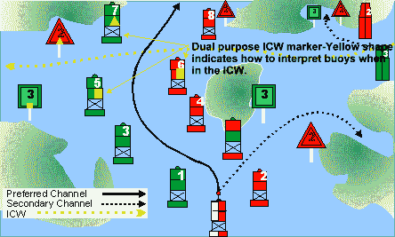
Intracoastal Waterway
The Intracoastal Waterway (ICW) runs parallel to the Atlantic and Gulf Coasts. Unofficially, it begins at Manasquan River, NJ, which leads to Mile Zero at Norfolk, VA, then on to Brownsville, TX and the Mexican Border. Most aids to navigation on the ICW are conventional day beacons and buoys, but the real identifier is the yellow triangle or square. As you travel on the ICW from NJ to TX, triangles stay on your right (towards the mainland) and squares stay on your left (to sea).
Examples
13
14

Slide 29
Western Rivers
When on the Mississippi River, above Baton Rouge, and several other tributaries that flow toward the Gulf of Mexico, boaters must follow a system called the Western Rivers Marking System, a variation of the U.S. Aids to Navigation System.
Red and green aids are not individually numbered or lettered, but may be accompanied by a mile marker.
Green aids are on the Right-descending bank and red aids are on the Left-descending bank.
Crossing markers are used on river bends. Inbound traffic takes the inside curve, Outbound takes the outside.
RED right Returning applies

Slide 30
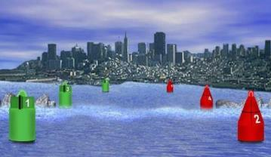
US Aids to Navigation (US ATONS)
U.S. Aids to Navigation (Navigable Waters Except Western Rivers and Intracoastal Waterway). Navigation aids in this lateral system are determined by their position with respect to the navigable channel, as the channels are entered and followed from seaward toward the head of navigation.
Green aids are odd numbered
Red aids are even numbered
RED right Returning applies

Slide 31
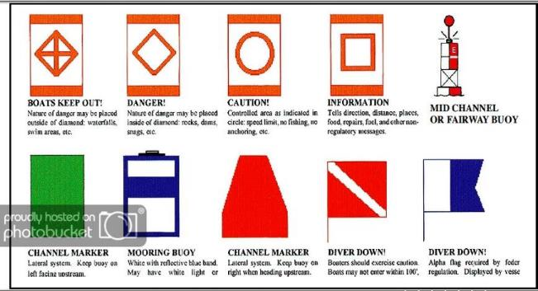
Uniform State Waterway Marking System
This system was replaced by the USATONS system in 2003.It was primarily used on lakes and other inland waterways not portrayed on nautical charts.

Slide 32
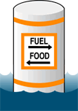
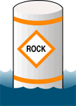
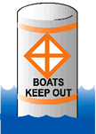
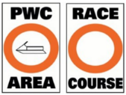
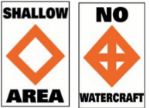
Regulatory
INFORMATION CONTROLLED DANGER EXCLUSION

Slide 33
Review:
Name the Navigation Systems
What are the two types of ATONS?
What mark(s) identify the Intracoastal Waterway?
Nun buoys are what color and have ___ numbers?
Can buoys are what color and have ___ numbers?
Name the four types of Regulatory Buoys

Slide 34
QUESTIONS?

